Slide 1


Committed to the growth of ALL: Students, Families, Community
2024-25
Proposed Budget

Slide 2
DISTRICT BUDGET
Fiscal Year: July 1 - June 30
Budget Finalized in October by School Board

Slide 3
Major Budget Factors
Property Value – October 1
  Preliminary estimate: 7.3% increase
Student Enrollment - 3rd Friday in September
  Projecting decrease of 24 students
Private School Voucher Aid Deduction – October 15
  Estimating $571,149 (55 students) - $552,711 in 23/24
State General Aid - October 15
  Using July 1st estimate from DPI (based on 23-24 Budgets – not Actual results)
District Adjustments

Slide 5
PROPERTY VALUATION
7.34%

Slide 6

Revenue Limit Membership

Slide 7
ENROLLMENT -- PREVIOUS & PROJECTED FUTURE
(4k, PAA not included)

Slide 8


Operational Referendum
Operational Dollars Available = $55,400,000
Total Unspent/Untaxed Referendum Dollars = $10,679,318
$1.5 million/year $2.6 million/year $3.7M/year

Slide 9

Budget Revenues: State Aid (52%) and Taxes (42%)

Slide 10
TAX LEVY

Slide 11
Each Municipality’s share of the levy
is determined by its share of the total equalized value.

Slide 12
PROJECTED TAX IMPACT
$6.21 $8.11
(w/o Nov. ‘24 referendum) (w/ Nov. ‘24 referendum)
$185,000 Home
$1,149 --School Tax $1,500 – School Tax
(before School Levy Credit) (before School Levy Credit)

Slide 13
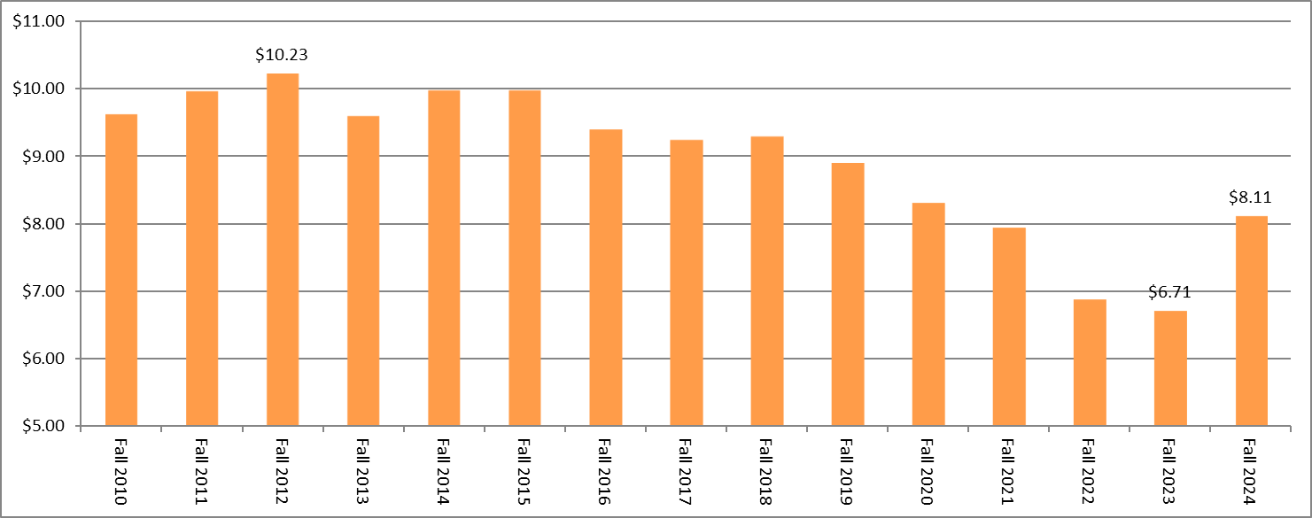
Tax Rate – History

Slide 15

Note:
  Budget adjustments are made in October
  based on student enrollment, state aid
  certification, transfer of service allocation,
  district adjustments, the state voucher
  program, and property valuations.

Slide 16
Annual Meeting Packet
DPI Recommended Format
        Does include some State/Federal Grants

Slide 17
FUND BALANCE

Slide 18
CAPITAL IMPROVEMENTS

Slide 19

FOOD SERVICE

Slide 20
TAX LEVY

Slide 21
